Slide 1

Marketing Attribution
Analyze Data with SQL
Iván Velázquez
20-06-2020

Slide 2
Table of Contents
1. About the Company
1.1 Background
1.2 UTM campaign and UTM source
1.3 Campaigns and sources information
2. User journey
2.1 First touches
2.1 Last touches
2.3 Purchases
2.4 User journey
3. Optimization of campaign Budget

Slide 3
1. About the company

Slide 4
1.1 Background
CoolTshirts is a clothing company with a wide variety of designs at an affordable price. Recently, the company started some marketing campaigns to increase website visits and purchases.
The way to map customers is by using touch attribution, that is, from initial visit to purchase.
In this project, several SQL queries were made to obtain useful insights and identify which campaigns the company should re-invest.

Slide 5
1.2 UTM campaign and UTM source
Urchin Traffic Monitor(UTM) is a way of measuring and calculating where the traffic to a website comes from. It helps in the monitoring and analytics of users. Also, these parameters allow us to analyze the effectiveness of marketing campaigns.
UTM campaign
Identify the campaign that has finally managed to attract traffic to a specific website
Examples: memorial-day-sale, the weekly newsletter, spring sale, etc.
UTM source
Identifies which site sent the traffic
•For example, if utm_source=Facebook
•Through this UTM code, you identify that the source from which a user has reached the site is Facebook.

Slide 6
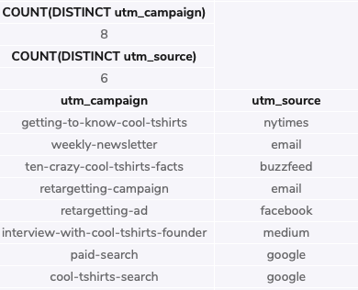
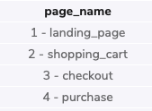
1.3 Campaigns and sources
As seen, with the queries presented four pieces of information were obtained :
Number of distinct campaigns developed by CoolTshits (8)
Number of distinct sources used (6)
The source used by each campaign
Pages found on the company website (4)
SELECT COUNT(DISTINCT utm_campaign) AS “num_campaigns”
FROM page_visits;
SELECT COUNT(DISTINCT utm_source) AS “num_sources”
FROM page_visits;
SELECT DISTINCT utm_campaign,utm_source
FROM page_visits;
SELECT DISTINCT page_name AS ”page_names”
FROM page_visits;

Slide 7
2. User journey

Slide 8
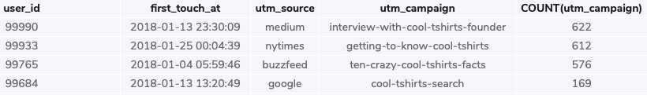
2.1 Number of first touches by each campaign
The following query helped to found the number of first touches each campaign is responsible for. This a good way to know how visitors initially discover the website. What was found from the latter is the following:
Only 4 out of the 8 campaigns are responsible for the first touches to the website.
Interview with CoolTshirts founder and getting to know cool T-shirts were the campaigns that were responsible for the highest number of first touches
The sources associated with these campaigns were medium and NYTimes.
WITH first_touch AS (
SELECT user_id,
MIN(timestamp) as first_touch_at
FROM page_visits
GROUP BY user_id)
SELECT ft.user_id,
ft.first_touch_at,
pv.utm_source,
pv.utm_campaign,
COUNT(utm_campaign)AS “num_first_touches”
FROM first_touch ft
JOIN page_visits pv
ON ft.user_id = pv.user_id
AND ft.first_touch_at = pv.timestamp
GROUP BY utm_campaign
ORDER BY 5 DESC;

Slide 9
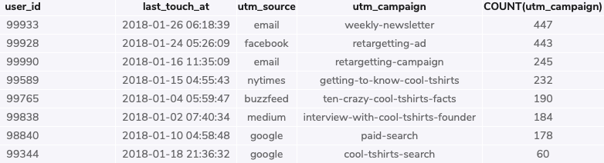
2.2 Number of last touches by each campaign
The following query helped to found the number of last touches each campaign is responsible for. The latter is useful because it can be known how visitors are drawn back to a website. What was found in the following:
The 8 campaigns are responsible for all the last touches.
Weekly newsletter and retargeting ad are the campaigns that are responsible for the highest number of last touches
The sources associated with this campaign are email and Facebook.
WITH last_touch AS (
SELECT user_id,
MAX(timestamp) as last_touch_at
FROM page_visits
GROUP BY user_id)
SELECT lt.user_id,
lt.last_touch_at,
pv.utm_source,
pv.utm_campaign,
COUNT(utm_campaign) AS ”num_last_touches”
FROM last_touch lt
JOIN page_visits pv
ON lt.user_id = pv.user_id
AND lt.last_touch_at = pv.timestamp
GROUP BY utm_campaign
ORDER BY 5 DESC;

Slide 10
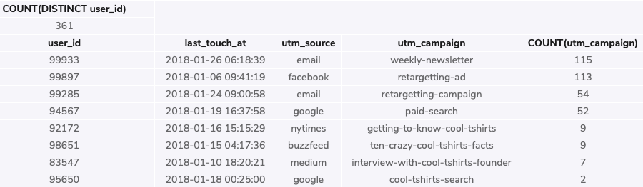
2.3 Number of purchases
The following queries determined the number of visitors who made a purchase and the number of last touches on the purchase page each campaign is responsible for. The following results were obtained:
The total of purchases were 361
The 8 campaigns contributed to the last touches on the purchase page
Weekly newsletter and retargeting ad campaigns were the ones to contributed the most to the last touches on the purchase page
The sources associated with these campaigns were email and Facebook.
-- Number of purchases
SELECT COUNT(DISTINCT user_id)
FROM page_visits
WHERE page_name = '4 - purchase’;
-- Number of last touches on the purchase page by campaign
WITH last_touch AS (
SELECT user_id,
MAX(timestamp) as last_touch_at
FROM page_visits
WHERE page_name = '4 - purchase'
GROUP BY user_id)
SELECT lt.user_id,
lt.last_touch_at,
pv.utm_source,
pv.utm_campaign,
COUNT(utm_campaign)AS ”num_last_touch_purchase_page”
FROM last_touch lt
JOIN page_visits pv
ON lt.user_id = pv.user_id
AND lt.last_touch_at = pv.timestamp
GROUP BY utm_campaign
ORDER BY 5 DESC;

Slide 11
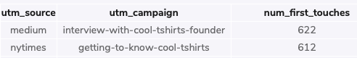
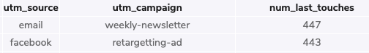
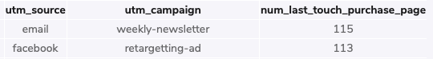
2.3 User Journey
According to the previous results, the typical user journey is the following:
First, users initially discover the web site through interviews with cool t-shirts founder and getting to know cool t-shirts campaigns, found in medium and NYTimes.
Then, how users are drawn back to the website is due to the weekly newsletter and retargeting ad campaigns found in email and Facebook.
Finally, the purchase is done as well due to the previous campaigns and its corresponding source.

Slide 12
3. Optimization of campaign budget

Slide 13
Recommendations for the company
The five campaigns that CoolTshirts should re-invest may vary because other factors need to be considered when these type of decisions are taken. However, according to the information obtained from the analysis the proposal is the following:
1. Weekly newsletter.
This campaign is responsible for the highest number of last touches, considering the ones as well that led to a purchase. So it is a
2. Retargeting ad
This campaign is also one of the most effective in the matter of last touches, considering the ones that led to a purchase. It is important to maintain the campaigns that led to more profits.
3. Retargeting campaign
The latter seems to be a good campaign to re-invest in. This is because is the third with the highest quantity of last touches and purchases.
4. Interview with cool T shirts founder
In terms of first touches, this campaign is the most fruitful. Most of the people discover CoolTshirts web site because of this. So, re-investing may lead to more purchases in the coming years if more people know the page.
5. Getting to know coolTshirts
The above campaign the second most effective campaign in terms of first touches. Investing in this campaign may lead to new users getting to know the page as with the previous one.

